Slide 1

Geometry
Unit 9, Lesson 2 Density Based on Area Volume 2, pg. 59

Slide 2


Benchmark
MA.912.GR.4.4
Solve mathematical and real-world problems involving the area of two-dimensional figures.
volume 2, pg. 59

Slide 3
Integrated Mathematical Thinking and Reasoning Standards
MA.K12.MTR.1.1 Actively participate in effortful learning both individually and collectively.
MA.K12.MTR.2.1 Demonstrate understanding by representing problems in multiple ways.
MA.K12.MTR.3.1 Complete tasks with mathematical fluency.
MA.K12.MTR.4.1 Engage in discussions that reflect on the mathematical thinking of self and others.
MA.K12.MTR.5.1 Use patterns and structure to help understand and connect mathematical concepts.
MA.K12.MTR.7.1 Apply mathematics to real-world contexts.
volume 2, pg. 59

Slide 4

Learning Target
I can solve real-world problems that involve density using area.
volume 2, pg. 59

Slide 5

Warm-Up
volume 2, pg. 59

Slide 6
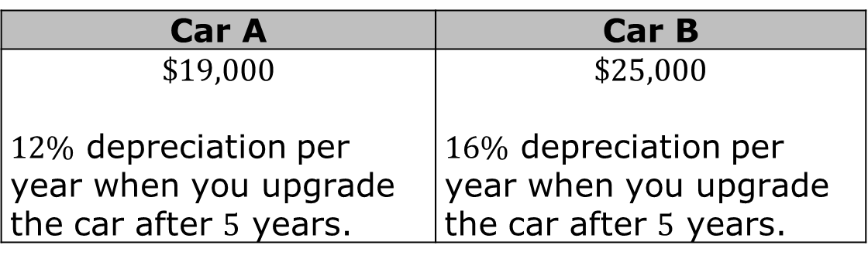
9.2.1 Warm-Up: Would You Rather?
Which car would you rather buy?
Explain your answer.
Car A | Car B
$$\$19,000$$ $12\%$ depreciation per year when you upgrade the car after $5$ years. | $$\$25,000$$ $16\%$ depreciation per year when you upgrade the car after $5$ years.
volume 2, pg. 59

Slide 7

Collaboration
volume 2, pg. 60

Slide 8

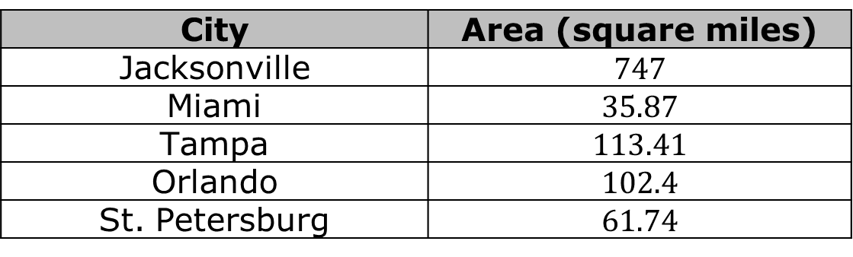
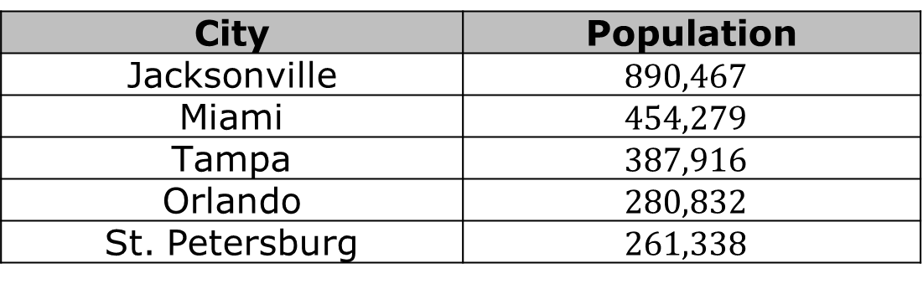
9.2.2 Collaboration: Population Density
The five largest cities in Florida and their populations are shown.
The table shows the area of Florida’s five largest cities.
City | Population
Jacksonville | $$890,467$$
Miami | $$454,279$$
Tampa | $$387,916$$
Orlando | $$280,832$$
St. Petersburg | $$261,338$$
City | Area (square miles)
Jacksonville | $$747$$
Miami | $$35.87$$
Tampa | $$113.41$$
Orlando | $$102.4$$
St. Petersburg | $$61.74$$
volume 2, pg. 60

Slide 9
What Do You Notice About the Population and the Area?
volume 2, pg. 60

Slide 10
Discuss with your partner your understanding of population density. Describe the population density for the city or town you live in.
Make predictions about the population density for Florida’s five largest cities.
Largest Population Density | Smallest Population Density
volume 2, pg. 60

Slide 11
Explain your thinking.
Ask a classmate for the predictions they made as well as their reasons. Record their cities and write your summary of their reason. You are the only person who should write in the middle two columns of the table. Have the person initial next to your summary stating that your summary was correct.
 | City | My Summary of Their Reason | Initials
Largest Population Density
Smallest Population Density
volume 2, pg. 60

Slide 12

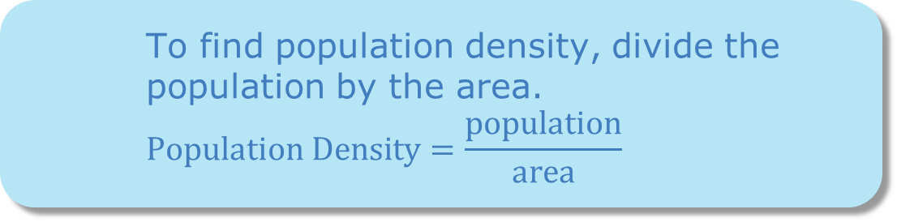
To find population density, divide the population by the area.
$$Population Density=\frac{population}{area}$$
volume 2, pg. 61

Slide 13

Determine the population density, in persons per square mile $\left(persons/{mi}^{2}\right)$, of the five largest cities in Florida and record them in the table from largest to smallest. Round answers to the nearest whole number.
On July 1, 2019, Florida had a population of $21,477,737$. The area of Florida is $53,624.76$ square miles. Find the population density of Florida.
City | Population Density (persons/mi.²)
1.
2.
3.
4.
5.
volume 2, pg. 61

Slide 14

Guided Instruction
volume 2, pg. 61

Slide 15
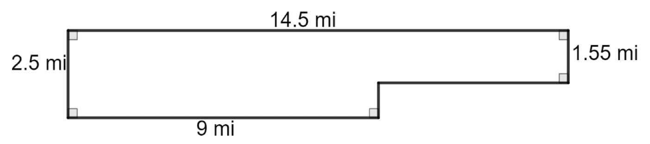
9.2.3 Guided Instruction: Area and Density
An outline of the city of Miramar, Florida, with measurements in miles (mi), is shown.
What is the area of the city, in square miles?
volume 2, pg. 61

Slide 16
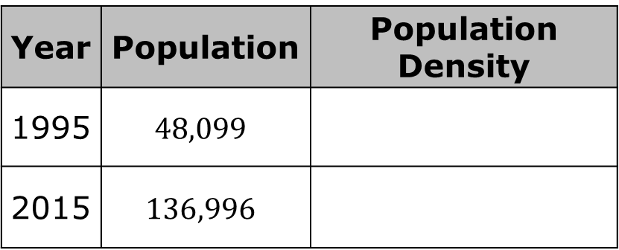
Determine the population density of Miramar for 1995 and 2015. Include units.
How did the population density change between 1995 to 2015?
Year | Population | Population Density
1995 | $$48,099$$
2015 | $$136,996$$
volume 2, pg. 61

Slide 17
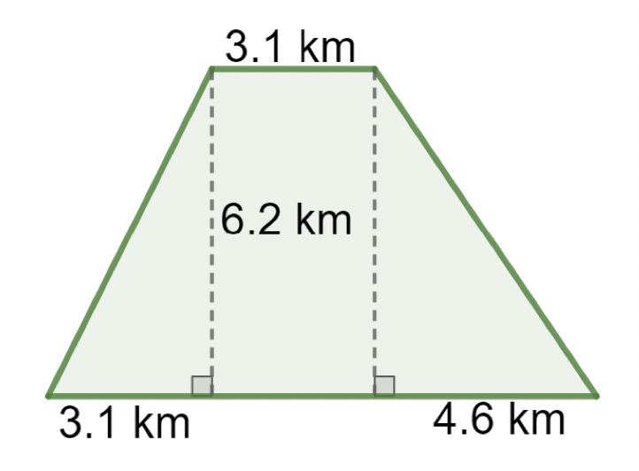

The Florida Fish and Wildlife Conservation Commission (FWC) tracks panthers in Florida. By tracking a panther, FWC can map the area in which a panther lives. The habitat of "Florida Panther 251" is shown with dimensions in kilometers, km.
What is the area, in square kilometers (${km}^{2})$, of Florida Panther 251’s habitat?
volume 2, pg. 62

Slide 18
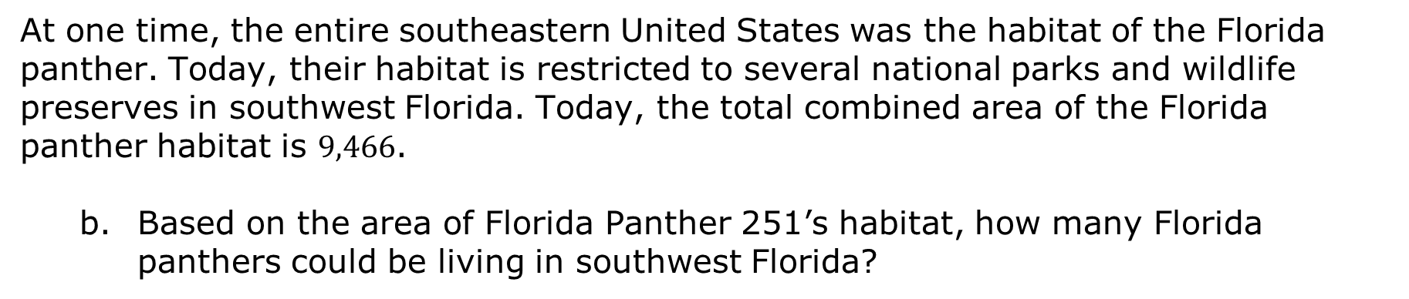
At one time, the entire southeastern United States was the habitat of the Florida panther. Today, their habitat is restricted to several national parks and wildlife preserves in southwest Florida. Today, the total combined area of the Florida panther habitat is $9,466$.
Based on the area of Florida Panther 251’s habitat, how many Florida panthers could be living in southwest Florida?
volume 2, pg. 62

Slide 19
Town A has 20 city blocks, and each city block measures $\frac{1}{20}$ of a mile by $\frac{1}{2}$ mile. There are $6,500$ people in this town. Find the population density of the town.
volume 2, pg. 62

Slide 20

Guided Practice
volume 2, pg. 63

Slide 21

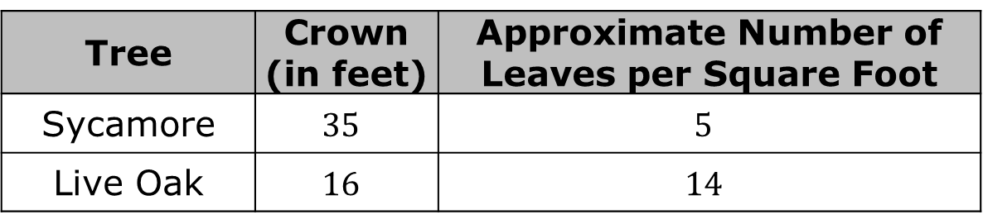
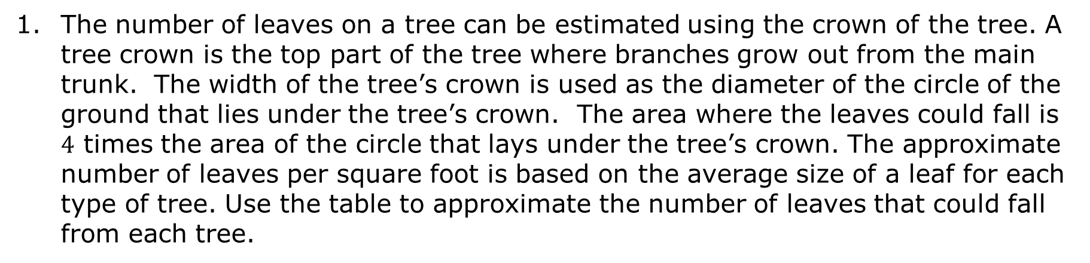
9.2.4 Guided Practice: Density Based on Area
The number of leaves on a tree can be estimated using the crown of the tree. A tree crown is the top part of the tree where branches grow out from the main trunk. The width of the tree’s crown is used as the diameter of the circle of the ground that lies under the tree’s crown. The area where the leaves could fall is $4$ times the area of the circle that lays under the tree’s crown. The approximate number of leaves per square foot is based on the average size of a leaf for each type of tree. Use the table to approximate the number of leaves that could fall from each tree.
Tree | Crown (in feet) | Approximate Number of Leaves per Square Foot
Sycamore | $$35$$ | $$5$$
Live Oak | $$16$$ | $$14$$
volume 2, pg. 63

Slide 22
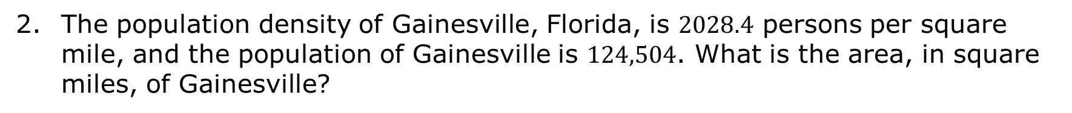
The population density of Gainesville, Florida, is $2028.4$ persons per square mile, and the population of Gainesville is $124,504$. What is the area, in square miles, of Gainesville?
volume 2, pg. 63

Slide 23
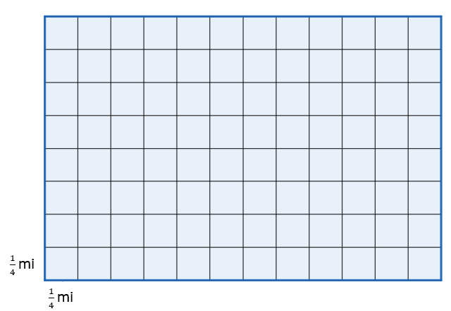
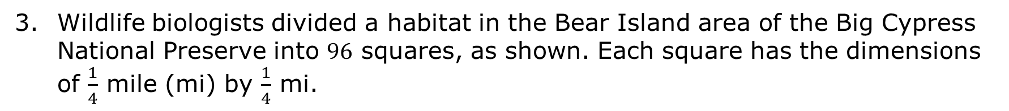
Wildlife biologists divided a habitat in the Bear Island area of the Big Cypress National Preserve into $96$ squares, as shown. Each square has the dimensions of $\frac{1}{4}$ mile (mi) by $\frac{1}{4}$ mi.
volume 2, pg. 64

Slide 24
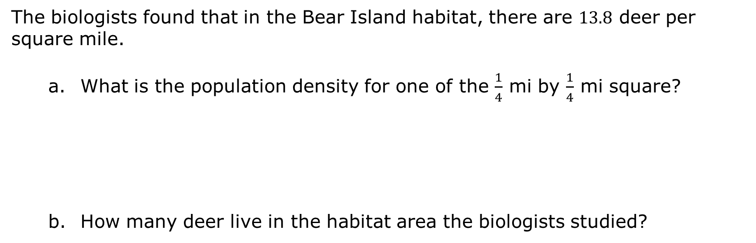
The biologists found that in the Bear Island habitat, there are $13.8$ deer per square mile.
What is the population density for one of the $\frac{1}{4}$ mi by $\frac{1}{4}$ mi square?
How many deer live in the habitat area the biologists studied?
volume 2, pg. 64

Slide 25

Wrap-Up
volume 2, pg. 64

Slide 26
9.2.5 Wrap-Up: Cool Down
Write an explanation to a classmate who might have missed today’s lesson, in your own words, about population density.
volume 2, pg. 64

